Slide 1
My Introduction
ZHANG XINGNAN CST1909169

Slide 2
Basic information
My name is Zhang Xingnan,a Chinese student.
My hometown is Yinchuan,Ningxia Province.
There are many parks and rivers located in my hometown.

Slide 3

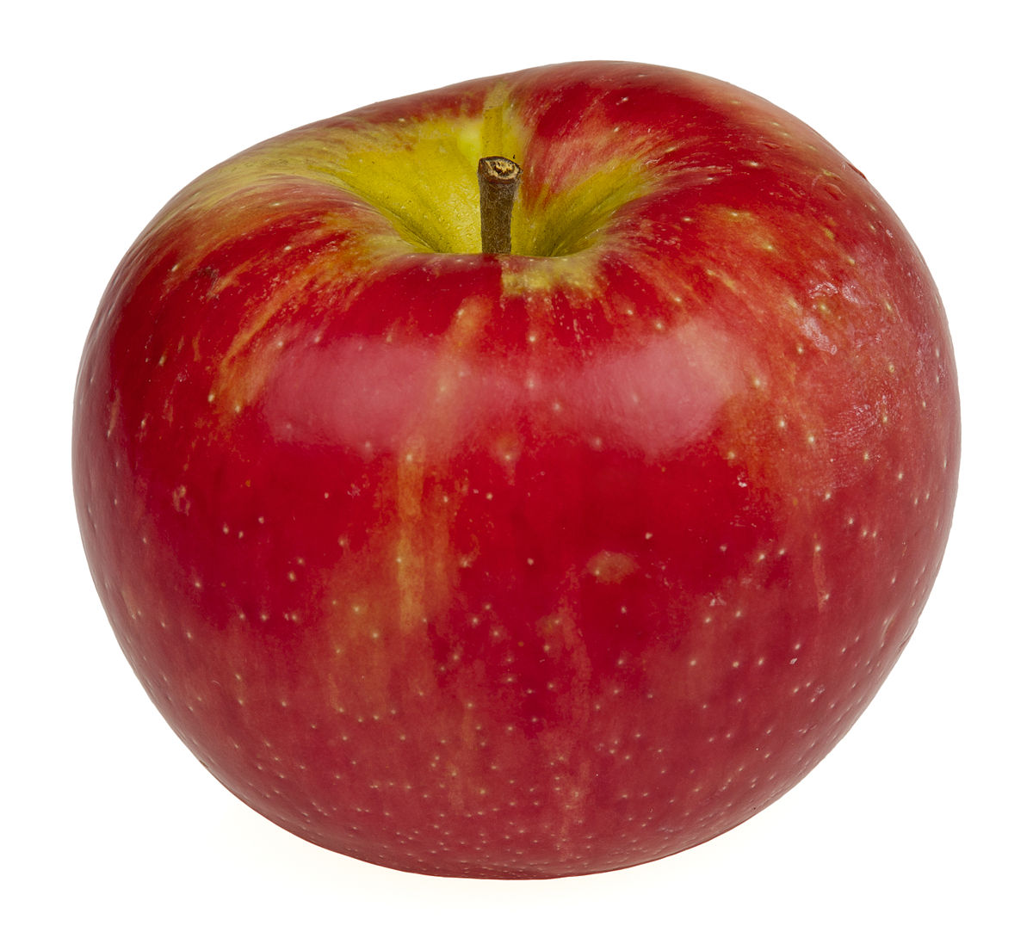
My favourite
Fruits: apples,pitaya
Books: Harry Potter
Games:Sniper,Assassin’s Creed,Werewolves of Miller’s Hollow
This Photo by Unknown Author is licensed under CC BY-SA

Slide 4

Byebye
This Photo by Unknown Author is licensed under CC BY-SA

